Slide 1
Digital Design &
Computer Architecture
Sarah Harris & David Harris
Chapter 5:
Digital Building Blocks

Slide 2
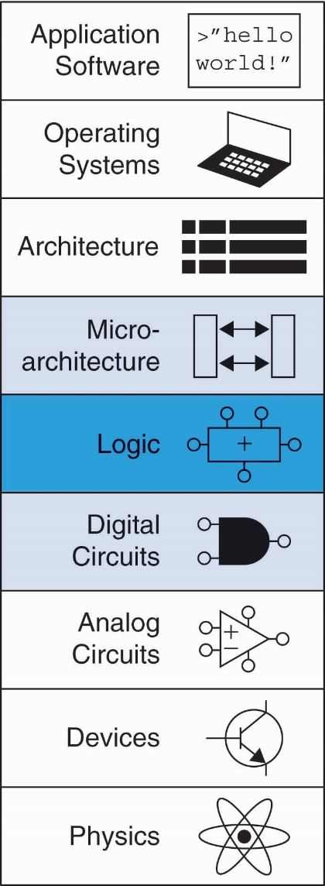
Chapter 5 :: Topics
Introduction
Arithmetic Circuits
Number Systems
Sequential Building Blocks
Memory Arrays
Logic Arrays

Slide 3
Introduction
Digital building blocks:
Gates, multiplexers, decoders, registers, arithmetic circuits, counters, memory arrays, logic arrays
Building blocks demonstrate hierarchy, modularity, and regularity:
Hierarchy of simpler components
Well-defined interfaces and functions
Regular structure easily extends to different sizes
We’ll use these building blocks in Chapter 7 to build a microprocessor

Slide 4
Chapter 5: Digital Building Blocks
Adders

Slide 5
1-Bit Adders

Slide 6
Multibit Adders: CPAs
Types of carry propagate adders (CPAs):
Ripple-carry (slow)
Carry-lookahead (fast)
Prefix (faster)
Carry-lookahead and prefix adders faster for large adders but require more hardware
Symbol

Slide 7
Chapter 5: Digital Building Blocks
Ripple Carry
Addition

Slide 8
Ripple-Carry Adder
Chain 1-bit adders together
Carry ripples through entire chain
Disadvantage: slow

Slide 9
Ripple-Carry Adder Delay
t_{ripple} = Nt_{FA}
where t_{FA} is the delay of a 1-bit full adder

Slide 10
Chapter 5: Digital Building Blocks
Carry Lookahead
Addition

Slide 11
Carry-Lookahead Adder
Compute C_{out} for k-bit blocks using generate and propagate signals
Some definitions:
Column i produces a carry out by either generating a carry out or propagating a carry in to the carry out
Calculate generate (G_{i}) and propagate (P_{i}) signals for each column:
Generate: Column i will generate a carry out if A_{i} and B_{i} are both 1.
G_{i} = A_{i} B_{i}
Propagate: Column i will propagate a carry in to the carry out if A_{i} or B_{i} is 1.
P_{i} = A_{i} + B_{i}
Carry out: The carry out of column i (C_{i}) is:
C_{i} = A_{i} B_{i} + (A_{i} + B_{i} )C_{i-1} = G_{i} + P_{i} C_{i-1}

Slide 12
Propagate and Generate Signals
Examples: Column propagate and generate signals:
Column propagate: P_{i} = A_{i} + B_{i}
Column generate: G_{i} = A_{i} B_{i}
C_{i} = G_{i} + P_{i} C_{i-1}

Slide 13
Block Propagate and Generate
Now use column Propagate and Generate signals to compute Block Propagate and Block Generate signals for k-bit blocks, i.e.:
Compute if a k-bit group will propagate a carry in (of the block) to the carry out (of the block)
Compute if a k-bit group will generate a carry out (of the block)

Slide 14
Block Propagate and Generate
Example: 4-bit blocks
Block propagate signal: P_{3:0} (single-bit signal)
A carry-in would propagate through all 4 bits of the block:
P_{3:0} = P₃P₂ P₁P₀
Examples:

Slide 15
Block Propagate and Generate
Example: 4-bit blocks
Block propagate signal: P_{3:0} (single-bit signal)
A carry-in would propagate through all 4 bits of the block:
P_{3:0} = P₃P₂ P₁P₀
Block generate signal: G_{3:0} (single-bit signal)
A carry is generated:
in column 3, or
in column 2 and propagated through column 3, or
in column 1 and propagated through columns 2 and 3, or
in column 0 and propagated through columns 1-3
G_{3:0} = G₃ + G₂P₃ + G₁P₂P₃ + G₀P₁P₂P₃
G_{3:0} = G₃ + P₃ [G₂ + P₂ (G₁ + P₁G₀ )]

Slide 16
Block Propagate and Generate
Example: 4-bit blocks
Block generate signal: G_{3:0} (single-bit signal)
A carry is: generated in column 3, or generated in column 2 and propagated through column 3, or ...
G_{3:0} = G₃ + G₂P₃ + G₁P₂P₃ + G₀P₁P₂P₃

Slide 17
Block Propagate and Generate
Example: 4-bit blocks
Block propagate signal: P_{3:0} (single-bit signal)
A carry-in would propagate through all 4 bits of the block:
P_{3:0} = P₃P₂ P₁P₀
Block generate signal: G₃₋₀ (single-bit signal)
A carry is generated:
in column 3, or
in column 2 and propagated through column 3, or
in column 1 and propagated through columns 2 and 3, or
in column 0 and propagated through columns 1-3
G_{3:0} = G₃ + G₂P₃ + G₁P₂P₃ + G₀P₁P₂P₃
G_{3:0} = G₃ + P₃ [G₂ + P₂ (G₁ + P₁G₀ )]
C₃ = G_{3:0} + P_{3:0} C₋₁

Slide 18
Block Propagate and Generate
Example: Block propagate and generate signals for 4-bit blocks (P_{3:0} and G_{3:0}):
P_{3:0} = P₃P₂ P₁P₀
G_{3:0} = G₃ + P₃ (G₂ + P₂ (G₁ + P₁G₀ )
C₃ = G_{3:0} + P_{3:0} C₋₁

Slide 19
32-bit CLA with 4-bit Blocks

Slide 20
Carry-Lookahead Addition
Step 1: Compute G_{i} and P_{i} for all columns
Step 2: Compute G and P for k-bit blocks
Step 3: C_{in} propagates through each k-bit propagate/generate logic (meanwhile computing sums)
Step 4: Compute sum for most significant k-bit block

Slide 21
Carry-Lookahead Addition
Step 1: Compute G_{i} and P_{i} for all columns
G_{i} = A_{i} B_{i}
P_{i} = A_{i} + B_{i}

Slide 22
Carry-Lookahead Addition
Step 1: Compute G_{i} and P_{i} for all columns
Step 2: Compute G and P for k-bit blocks
P_{3:0} = P₃P₂ P₁P₀
G_{3:0} = G₃ + P₃ (G₂ + P₂ (G₁ + P₁G₀ )

Slide 23
Carry-Lookahead Addition
Step 1: Compute G_{i} and P_{i} for all columns
Step 2: Compute G and P for k-bit blocks
Step 3: C_{in} propagates through each k-bit propagate/generate logic (meanwhile computing sums)
B
31:28
A
31:28
B
27:24
A
27:24
B
7:4
A
7:4
B
3:0
A
3:0
C
4-bit CLA
C
27
4-bit CLA
C
23
C
7
4-bit CLA
C
3
4-bit CLA
C
out
Block
Block
Block
Block
in
S
31:28
S
27:24
S
7:4
S
3:0
B
3
+
A
3
C
2
B
2
+
A
2
C
1
B
1
+
A
1
C
0
B
0
+
A
0
C
in
G
S
3
S
2
S
1
S
0
G
B
3
A
3
C
2
B
2
A
2
C
1
B
1
A
1
C
0
B
0
A
0
C
3:0
P
3
+
+
+
+
in
B
A
B
A
B
A
B
A
G
3
S
S
S
S
3
3
2
2
1
1
0
0
P
2
3
2
1
0
C
2
C
1
C
0
C
G
2
G
+
+
+
+
in
P
1
3:0
G
3
G
1
P
3
S
3
S
2
S
1
S
0
B
A
B
A
B
A
B
A
0
G
2
3
3
2
2
1
1
0
0
P
2
G
3:0
G
C
2
C
1
C
0
P
P
3
G
1
P
3
+
+
+
+
C
in
C
out
3:0
P
2
P
1
G
3
C
P
1
G
0
P
2
S
3
S
2
S
1
S
0
in
P
0
G
2
P
P
1
G
G
C
P
3:0
P
3
G
1
3:0
P
3
out
C
P
2
0
G
3
in
P
1
P
2
0
C
P
P
3
G
2
out
3:0
P
2
P
1
C
P
1
G
1
in
P
0
P
0
C
out
P
3:0
P
3
C
P
2
in
P
1
0

Slide 24
Carry-Lookahead Addition
Step 1: Compute G_{i} and P_{i} for all columns
Step 2: Compute G and P for k-bit blocks
Step 3: C_{in} propagates through each k-bit propagate/generate logic (meanwhile computing sums)
Step 4: Compute sum for most significant k-bit block
B
3
+
A
3
C
2
B
2
+
A
2
C
1
B
1
+
A
1
C
0
B
0
+
A
0
C
in
G
S
3
S
2
S
1
S
0
G
B
3
A
3
C
2
B
2
A
2
C
1
B
1
A
1
C
0
B
0
A
0
C
3:0
P
3
+
+
+
+
in
B
A
B
A
B
A
B
A
G
3
S
S
S
S
3
3
2
2
1
1
0
0
P
2
3
2
1
0
C
2
C
1
C
0
C
G
2
G
+
+
+
+
in
P
1
3:0
G
3
G
1
P
3
S
3
S
2
S
1
S
0
B
A
B
A
B
A
B
A
0
G
2
3
3
2
2
1
1
0
0
P
2
G
3:0
G
C
2
C
1
C
0
P
P
3
G
1
P
3
+
+
+
+
C
in
C
out
3:0
P
2
P
1
G
3
C
P
1
G
0
P
2
S
3
S
2
S
1
S
0
in
P
0
G
2
P
P
1
G
G
C
P
3:0
P
3
G
1
3:0
P
3
out
C
P
2
0
G
3
in
P
1
P
2
0
C
P
P
3
G
2
out
3:0
P
2
P
1
C
P
1
G
1
in
P
0
P
0
C
out
P
3:0
P
3
C
P
2
in
P
1
0

Slide 25
32-bit CLA with 4-bit Blocks

Slide 26
Carry-Lookahead Adder Delay
For N-bit CLA with k-bit blocks:
t_{CLA} = t_{pg} + t_{pg_block} + (N/k – 1)t_{AND_OR} + kt_{FA}
t_{pg} : delay to generate all P_{i}, G_{i}
t_{pg_block} : delay to generate all P_{i:j}, G_{i:j}
t_{AND_OR} : delay from C_{in} to C_{out} of final AND/OR gate in k-bit CLA block
An N-bit carry-lookahead adder is generally much faster than a ripple-carry adder for N > 16

Slide 27
Chapter 5: Digital Building Blocks
Prefix
Addition

Slide 28
Prefix Adder
Computes carry in (C_{i-1}) for each column, then computes sum:
S_{i} = (A_{i} ⊕ B_{i}) ⊕ C_{i-1}
It computes C_{i-1} by:
Computing G and P for 1-, 2-, 4-, 8-bit blocks, etc. until all G_{i} (carry in) known
G_{i} = C_{i}
log₂N stages

Slide 29
Prefix Adder
Carry out either generated in a column or propagated from a previous column.
Column -1 holds C_{in}, so
G₋₁ = C_{in}, P₋₁ = X (not used)
Carry in to column i = carry out of column i-1:
C_{i-1} = G_{i-1:-1}
G_{i-1:-1}: generate signal spanning columns i-1 to -1
Sum equation:
S_{i} = (A_{i} ⊕ B_{i}) ⊕ G_{i-1:-1}
Goal: Quickly compute G_{0:-1}, G_{1:-1}, G_{2:-1}, G_{3:-1}, G_{4:-1}, G_{5:-1}, … (called prefixes) (= C₀, C₁, C₂, C₃, C₄, C₅, …)

Slide 30
Prefix Adder
Generate and propagate signals for a block spanning bits i:j
G_{i:j} = G_{i:k} + P_{i:k} G_{k-1:j}
P_{i:j} = P_{i:k}P_{k-1:j}
In words:
Generate: block i:j will generate a carry if:
upper part (i:k) generates a carry (G_{i:k}) or
upper part (i:k) propagates a carry (P_{i:k}) generated in lower part (k-1:j) (G_{k-1:j})
Propagate: block i:j will propagate a carry if both the upper and lower parts propagate the carry (P_{i:k} AND P_{k-1:j})

Slide 31
Prefix Adder Example

Slide 32
Prefix Adder Schematic
A
i
B
i
15
14
13
12
11
10
9
8
7
6
5
4
3
2
1
0
-1
i
P
i:i
G
i:i
14:13
12:11
10:9
8:7
6:5
4:3
2:1
0:-1
P
i:k
P
k-1:j
G
i:k
G
k-1:j
14:11
13:11
10:7
9:7
6:3
5:3
2:-1
1:-1
i:j
14:7
13:7
12:7
11:7
6:-1
5:-1
4:-1
3:-1
P
G
i:j
i:j
14:-1
13:-1
12:-1
11:-1
10:-1
9:-1
8:-1
7:-1
G
i-1:-1
A
i
B
i
15
14
13
12
11
10
9
8
7
6
5
4
3
2
1
0
i
S
i

Slide 33
Prefix Adder Delay
t_{PA} = t_{pg} + log₂N(t_{pg_prefix} ) + t_{XOR}
t_{pg}: delay to produce P_{i}, G_{i} (AND or OR gate)
t_{pg_prefix}: delay of black prefix cell (AND-OR gate)

Slide 34
Adder Delay Comparisons
Compare the delay of: 32-bit ripple-carry, CLA, and prefix adders
CLA has 4-bit blocks
2-input gate delay = 100 ps; full adder delay = 300 ps
t_{ripple} = Nt_{FA} = 32(300 ps)
= 9.6 ns
t_{CLA} = t_{pg} + t_{pg_block} + (N/k – 1)t_{AND_OR} + kt_{FA}
= [100 + 600 + (7)200 + 4(300)] ps
= 3.3 ns
t_{PA} = t_{pg} + log₂N(t_{pg_prefix} ) + t_{XOR}
= [100 + log₂32(200) + 100] ps
= 1.2 ns

Slide 35
Chapter 5: Digital Building Blocks
Subtracters & Comparators

Slide 36
Subtracter
A – B = A + B + 1

Slide 37
Comparator: Equality

Slide 38
Comparator: Signed Less Than
A < B if A-B is negative
Beware of overflow

Slide 39
Chapter 5: Digital Building Blocks
ALU:
Arithmetic Logic Unit

Slide 40
ALU: Arithmetic Logic Unit
ALU should perform:
Addition
Subtraction
AND
OR

Slide 41
ALU: Arithmetic Logic Unit
ALUControl_{1:0} | Function
00 | Add
01 | Subtract
10 | AND
11 | OR
Example: Perform A OR B
ALUControl_{1:0} = 11
Result = A OR B

Slide 42
ALU: Arithmetic Logic Unit
ALUControl_{1:0} | Function
00 | Add
01 | Subtract
10 | AND
11 | OR
Example: Perform A OR B
ALUControl_{1:0} = 11
Mux selects output of OR gate as Result, so:
Result = A OR B

Slide 43
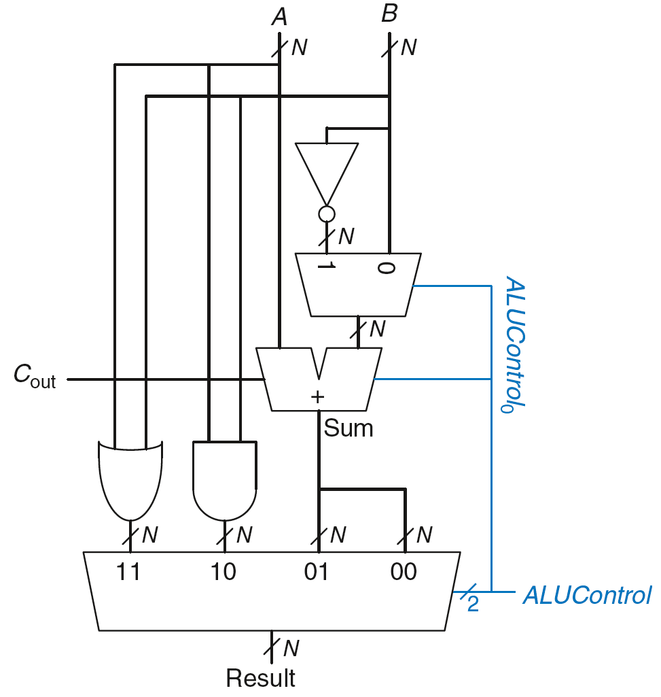
ALU: Arithmetic Logic Unit
ALUControl_{1:0} | Function
00 | Add
01 | Subtract
10 | AND
11 | OR
Example: Perform A + B
ALUControl_{1:0} = 00
ALUControl₀ = 0, so:
C_{in} to adder = 0
2nd input to adder is B
Mux selects Sum as Result, so
Result = A + B

Slide 44
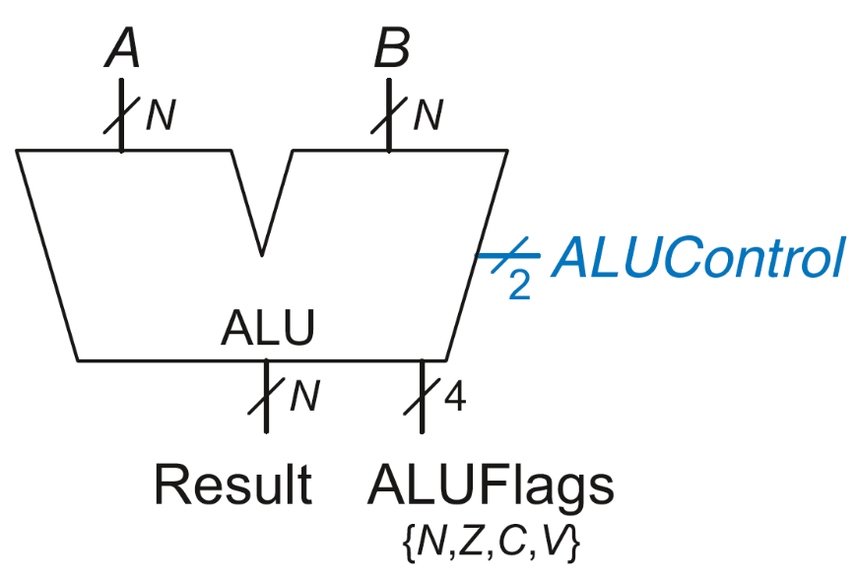
ALU with Status Flags
Flag | Description
N | Result is Negative
Z | Result is Zero
C | Adder produces Carry out
V | Adder oVerflowed

Slide 45
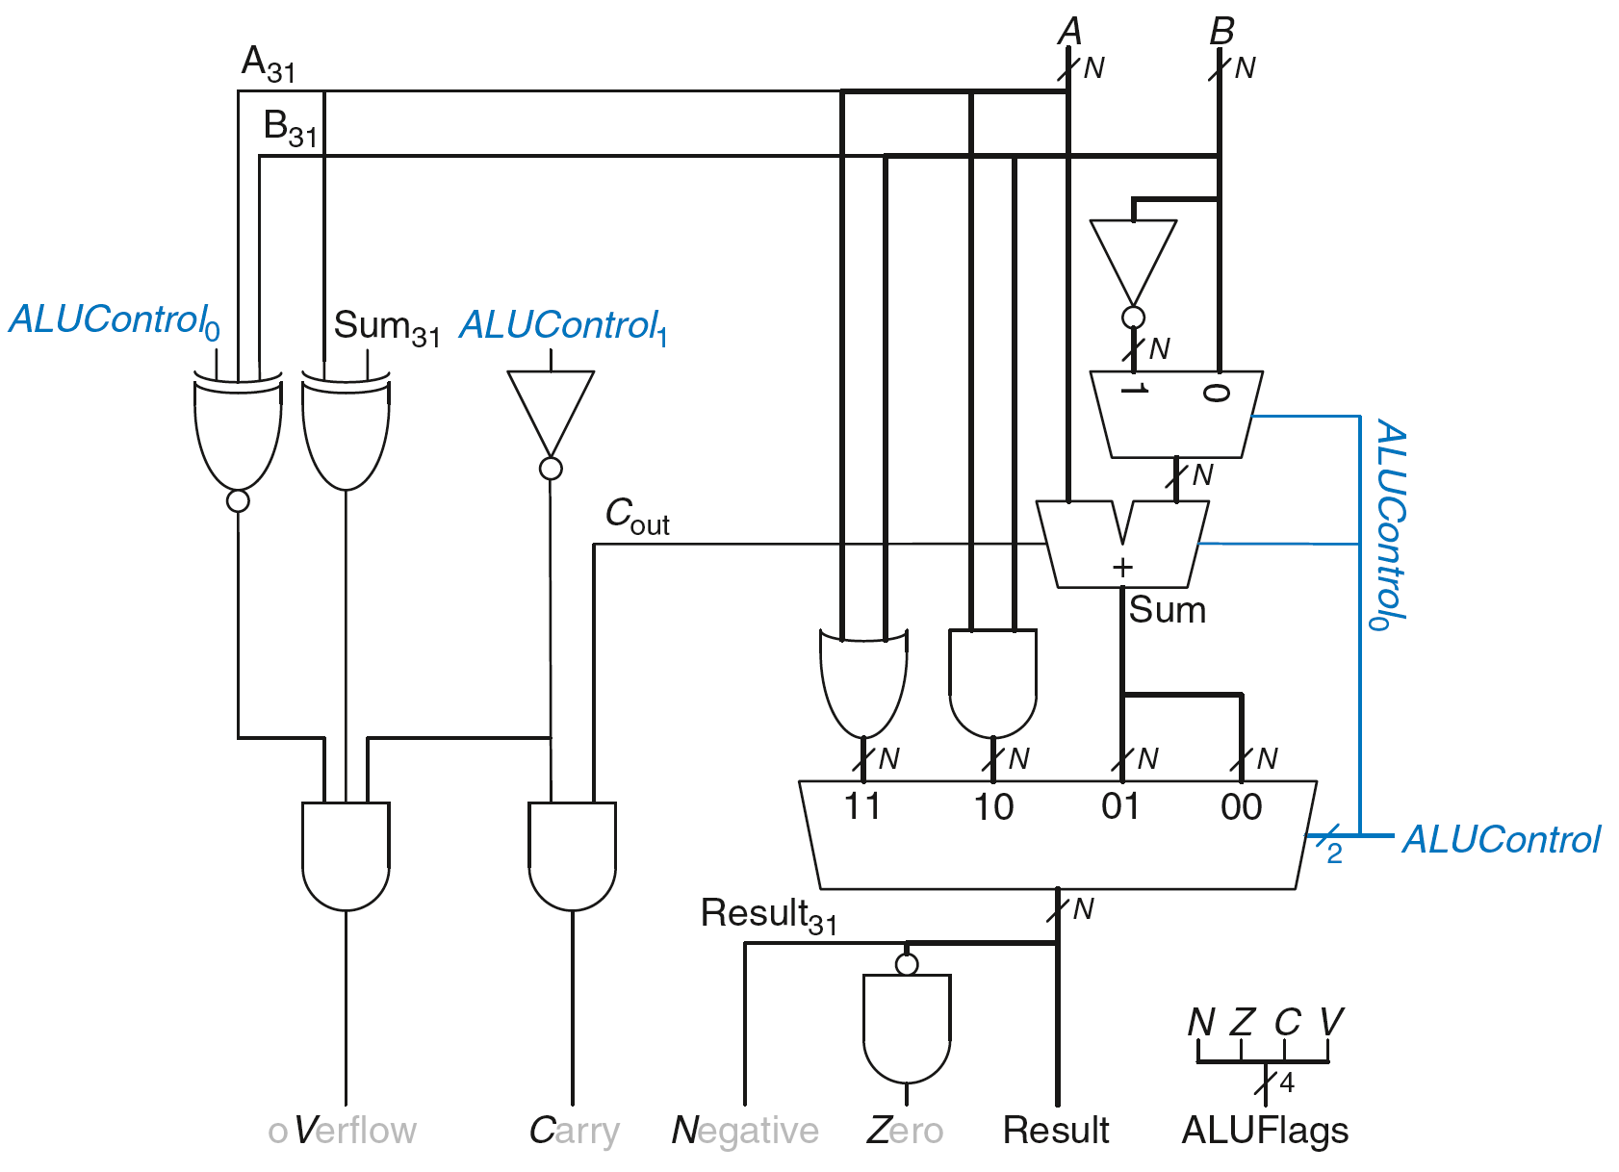
ALU with Status Flags

Slide 46
ALU with Status Flags: Negative
N = 1 if:
Result is negative
So, N is connected to most significant bit of Result.

Slide 47
ALU with Status Flags: Zero
Z = 1 if:
all of the bits of Result are 0

Slide 48
ALU with Status Flags: Carry
C = 1 if:
C_{out} of Adder is 1
AND
ALU is adding or subtracting (ALUControl is 00 or 01)

Slide 49
ALU with Status Flags: oVerflow
V = 1 if:
The addition of 2 same-signed numbers produces a result with the opposite sign

Slide 50
ALU with Status Flags: oVerflow
V = 1 if:
ALU is performing addition or subtraction
(ALUControl₁ = 0)
AND
A and Sum have opposite signs
AND
A and B have same signs for addition (ALUControl₀ = 0) OR
A and B have different signs for subtraction
(ALUControl₀ = 1)

Slide 51
ALU with Status Flags

Slide 52
Comparison based on Flags
Compare by subtracting and checking flags
Different for signed and unsigned
Comparison | Signed | Unsigned
== | Z | Z
!= | ~Z | ~Z
< | N ^ V | ~C
<= | Z | (N ^ V) | Z | ~C
> | ~Z & ~(N ^ V) | ~Z & C
>= | ~(N ^ V) | C

Slide 53
Other ALU Operations
Set Less Than (also called Set if Less Than)
Sets lsb of result if A < B
Result = 0000…001 if A < B
Result = 0000…000 otherwise
Comes in signed and unsigned flavors
XOR
Result = A XOR B

Slide 54
Extending ALU: SLT
ALUControl_{2:0} | Function
000 | add
001 | subtract
010 | and
011 | or
101 | SLT

Slide 55
Fixing Overflow Error in SLT Logic

Slide 56
Chapter 5: Digital Building Blocks
Shifters,
Multipliers,
& Dividers

Slide 57
Shifters
Logical shifter: shifts value to left or right and fills empty spaces with 0’s
Ex: 11001 >> 2 = 00110
Ex: 11001 << 2 = 00100
Arithmetic shifter: same as logical shifter, but on right shift, fills empty spaces with the old most significant bit (msb)
Ex: 11001 >>> 2 = 11110
Ex: 11001 <<< 2 = 00100
Rotator: rotates bits in a circle, such that bits shifted off one end are shifted into the other end
Ex: 11001 ROR 2 = 01110
Ex: 11001 ROL 2 = 00111

Slide 58
Shifter Design
Shift Left Logical Shift Right Arithmetic Shift Right

Slide 59
Shifters as Multipliers and Dividers
A << N = A × 2^{N}
Example: 00001 << 3 = 01000 (1 × 2³ = 8)
Example: 11101 << 2 = 10100 (-3 × 2² = -12)
A >>> N = A ÷ 2^{N}
Example: 01000 >>> 1 = 00100 (8 ÷ 2¹ = 4)
Example: 10000 >>> 2 = 11100 (-16 ÷ 2² = -4)

Slide 60
Multipliers
Partial products formed by multiplying a single digit of the multiplier with multiplicand
Shifted partial products summed to form result

Slide 61
4 x 4 Multiplier

Slide 62
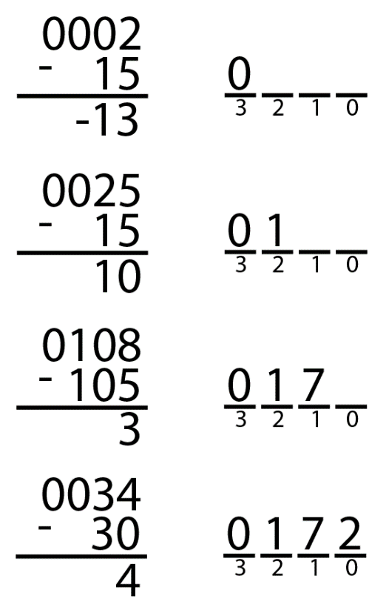
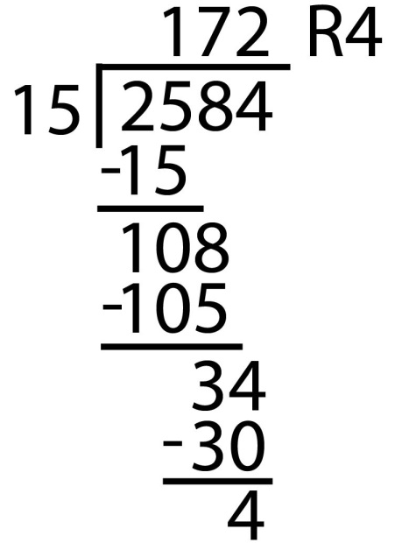
Dividers
A/B = Q + R/B
Decimal Example: 2584/15 = 172 R4
Long-Hand:
Long-Hand Revisited:

Slide 63

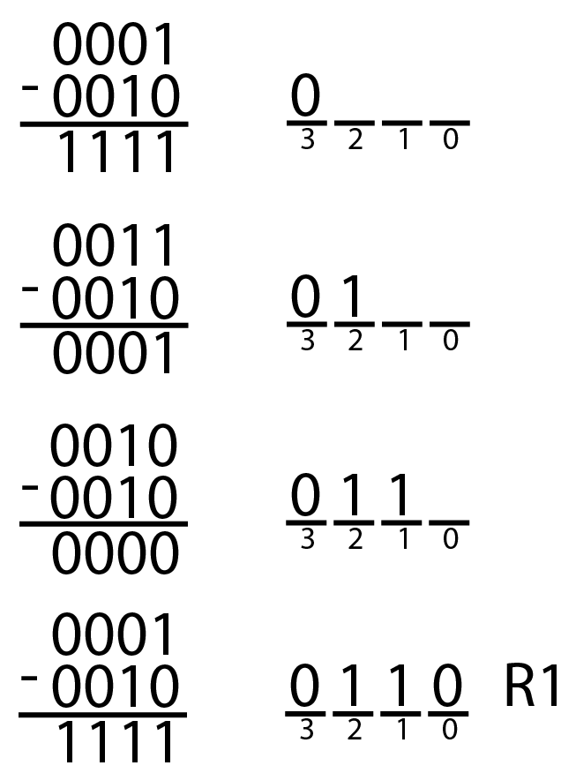
Dividers
A/B = Q + R/B
Decimal: 2584/15 = 172 R4
Binary: 1101/0010 = 0110 R1

Slide 64
Dividers
A/B = Q + R/B
R’ = 0
for i = N-1 to 0
R = {R’ << 1, A_{i}}
D = R - B
if D < 0, Q_{i}= 0; R’= R
else Q_{i}= 1; R’= D
R=R’
Binary: 1101/10 = 0110 R1

Slide 65
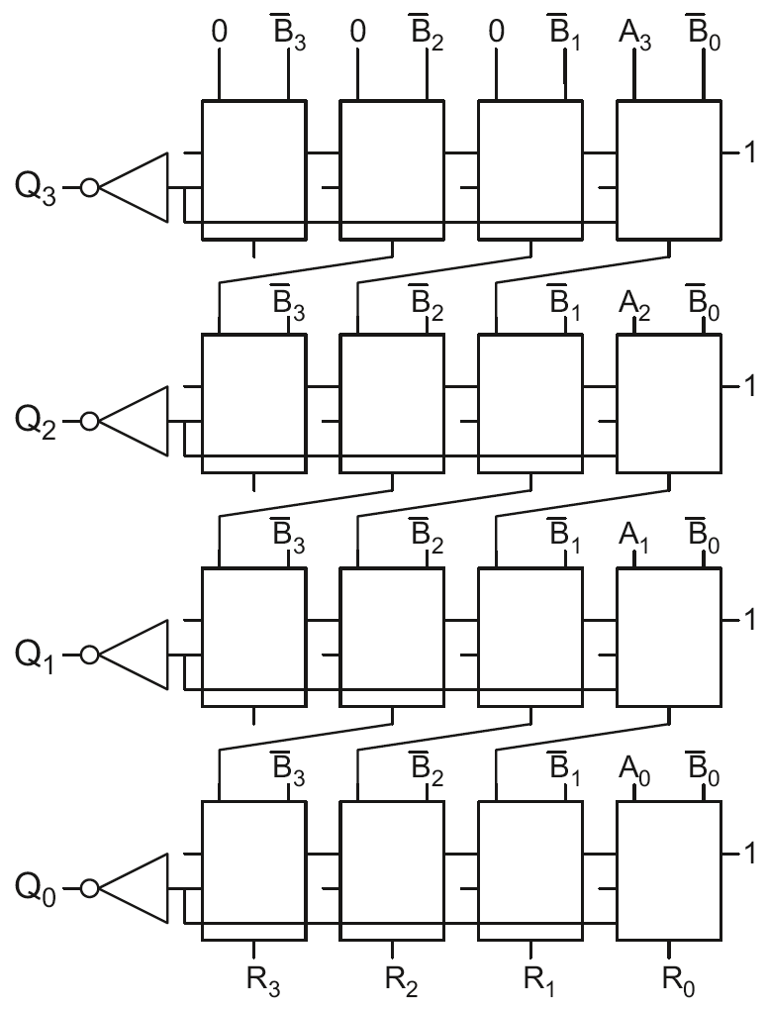
4 x 4 Divider
Division: A/B = Q + R/B
R’ = 0
for i = N-1 to 0
R = {R’ << 1, A_{i}}
D = R - B
if D < 0, Q_{i}=0, R’=R
else Q_{i}=1, R’=D
R=R’
Each row computes one iteration of the division algorithm.

Slide 66
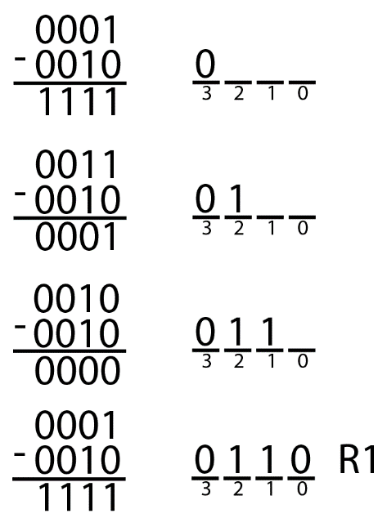
4 x 4 Divider
Each row computes one iteration of the division algorithm.

Slide 67
Chapter 5: Digital Building Blocks
Fixed-Point
Numbers

Slide 68
Number Systems
Numbers we can represent using binary representations
Positive numbers
Unsigned binary
Negative numbers
Two’s complement
Sign/magnitude numbers
What about fractions?

Slide 69
Numbers with Fractions
Two common notations:
Fixed-point: binary point fixed
Floating-point: binary point floats to the right of the most significant 1

Slide 70
Fixed-Point Numbers
6.75 using 4 integer bits and 4 fraction bits:
Binary point is implied
The number of integer and fraction bits must be agreed upon beforehand

Slide 71
Unsigned Fixed Point Formats
Ua.b: unsigned number with
a integer bits
b fractional bits.
Example: 6.75 is
U4.4: 01101100
U3.5: 11011000
U6.2: 00011011
8, 16, and 32-bit fixed point numbers are common
U8.8 often represents sensor data, audio, pixels
U16.16 used for higher precision signal processing

Slide 72
Signed Fixed Point Formats
Qa.b: signed 2’s complement number with
a integer bits (including the sign bit)
b fractional bits
To negate a Q fixed point number:
Invert the bits
Add one to the LSB
Example: write -6.75 in Q4.4
6.75 = 01101100
Invert: 10010011
Add 1 LSB: 10010100
Q1.15 (aka Q15) is common for signal processing (1, -1]

Slide 73
Saturating Arithmetic
Fixed point overflow is usually bad
Produces undesired artifacts:
Video: dark pixel in middle of bright pixels
Audio: clicking sounds
Saturating arithmetic
Instead of overflowing, use largest value
In U4.4: 11000000 + 01111000 = 11111111
12 + 7.5 = 15.9375

Slide 74
Chapter 5: Digital Building Blocks
Floating-Point
Numbers

Slide 75
Floating-Point Numbers
Binary point floats to the right of the most significant 1
Similar to decimal scientific notation
For example, write 273₁₀ in scientific notation:
273 = 2.73 × 10²
In general, a number is written in scientific notation as:
± M × B^{E}
M = mantissa
B = base
E = exponent
In the example, M = 2.73, B = 10, and E = 2

Slide 76
Floating vs. Fixed Point Numbers
Floating point numbers are like scientific notation
Allow a greater dynamic range of smallest to largest
Arithmetic is harder
Mantissa must be aligned before adding
This costs performance and power
Fixed point numbers are harder for the programmer
Smaller dynamic range
Take care of overflow
Floating Point is preferred for general-purpose computing where programming time is most important
Fixed Point is preferred for signal processing performance, power, and hardware cost matter most
Machine learning, video

Slide 77
Floating-Point Numbers
Example: represent the value 228₁₀ using a 32-bit floating point representation
We show three versions – the final version is called the:
IEEE 754 floating-point standard

Slide 78
Floating-Point Representation 1
Convert decimal to binary:
228₁₀ = 11100100₂
Write the number in “binary scientific notation”:
11100100₂ = 1.11001₂ × 2⁷
Fill in each field of the 32-bit floating point number:
The sign bit is positive (0)
The 8 exponent bits represent the value 7
The remaining 23 bits are the mantissa
A common error is to do step 2 first (and write the number in decimal scientific notation!)

Slide 79
Floating-Point Representation 2
First bit of the mantissa is always 1:
228₁₀ = 11100100₂ = 1.11001 × 2⁷
So, no need to store it: implicit leading 1
Store just fraction bits in 23-bit field

Slide 80
Floating-Point Representation 3
Biased exponent: bias = 127 (01111111₂)
Biased exponent = bias + exponent
Exponent of 7 is stored as:
127 + 7 = 134 = 0x10000110₂
The IEEE 754 32-bit floating-point representation of 228₁₀
in hexadecimal: 0x43640000

Slide 81
Floating-Point Example
Write -58.25₁₀ in floating point (IEEE 754)
Convert magnitude of decimal to binary:
58.25₁₀ = 111010.01₂
Write in binary scientific notation:
1.1101001 × 2⁵
Fill in fields:
Sign bit: 1 (negative)
8 exponent bits: (127 + 5) = 132 = 10000100₂
23 fraction bits: 110 1001 0000 0000 0000 0000
in hexadecimal: 0xC2690000

Slide 82
Floating-Point Special Cases
Number | Sign | Exponent | Fraction
0 | X | 00000000 | 00000000000000000000000
∞ | 0 | 11111111 | 00000000000000000000000
- ∞ | 1 | 11111111 | 00000000000000000000000
NaN | X | 11111111 | non-zero

Slide 83
Floating-Point Precision
Single-Precision:
32-bit
1 sign bit, 8 exponent bits, 23 fraction bits
bias = 127
Double-Precision:
64-bit
1 sign bit, 11 exponent bits, 52 fraction bits
bias = 1023

Slide 84
Floating-Point Rounding & Overflow
Overflow: number too large to be represented
Underflow: number too small to be represented
Rounding modes:
Down
Up
Toward zero
To nearest
Example: round 1.100101 (1.578125) to only 3 fraction bits
Down: 1.100
Up: 1.101
Toward zero: 1.100
To nearest: 1.101 (1.625 is closer to 1.578125 than 1.5 is)

Slide 85
Chapter 5: Digital Building Blocks
Floating-Point
Addition

Slide 86
Floating-Point Addition
Extract exponent and fraction bits
Prepend leading 1 to form mantissa
Compare exponents
Shift smaller mantissa if necessary
Add mantissas
Normalize mantissa and adjust exponent if necessary
Round result
Assemble exponent and fraction back into floating-point format

Slide 87
Floating-Point Addition Example
Add the following floating-point numbers:
0x3FC00000
0x40500000

Slide 88
Floating-Point Addition Example
1. Extract exponent and fraction bits
For first number (N1): S = 0, E = 127, F = .1
For second number (N2): S = 0, E = 128, F = .101
2. Prepend leading 1 to form mantissa
N1: 1.1
N2: 1.101
0x3FC00000
0x40500000

Slide 89
Floating-Point Addition Example
3. Compare exponents
127 – 128 = -1, so shift N1 right by 1 bit
4. Shift smaller mantissa if necessary
shift N1’s mantissa: 1.1 >> 1 = 0.11 (× 2¹)
5. Add mantissas
0.11 × 2¹
+ 1.101 × 2¹
10.011 × 2¹

Slide 90
Floating-Point Addition Example
6. Normalize mantissa and adjust exponent if necessary
10.011 × 2¹ = 1.0011 × 2²
7. Round result
No need (fits in 23 bits)
8. Assemble exponent and fraction back into floating-point format
S = 0, E = 2 + 127 = 129 = 10000001₂, F = 001100...
in hexadecimal: 0x40980000

Slide 91
Chapter 5: Digital Building Blocks
Counters & Shift Registers

Slide 92
Counters
Increments on each clock edge
Used to cycle through numbers. For example,
000, 001, 010, 011, 100, 101, 110, 111, 000, 001…
Example uses:
Digital clock displays
Program counter: keeps track of current instruction executing

Slide 93
Counter SystemVerilog Idiom
module counter(input logic clk, reset,
output logic [7:0] q);
always_ff @(posedge clk)
if (reset) q <= 0; // synchronous reset
else q <= q+1; //
end
// alternative more verbose
module counter(input logic clk, reset,
output logic [7:0] q);
logic [7:0] nextq;
assign nextq = q + 1; // adder
always_ff @(posedge clk) // state register with synchronous reset
if (reset) q <= 0;
else q <= nextq;
end

Slide 94
Divide-by-2^{N} Counter
Most significant bit of an N-bit counter toggles every 2^{N} cycles.
Useful for slowing a clock. Ex: blink an LED
Example: 50 MHz clock, 24-bit counter
2.98 Hz

Slide 95
Digitally Controlled Oscillator
N-bit counter
Add p on each cycle, instead of 1
Most significant bit toggles at f_{out} = f_{clk} * p / 2^{N}
Example: f_{clk} = 50 MHz clock
How to generate a f_{out} = 200 Hz signal?
p/2^{N} = 200 / 50 MHz
Try N = 24, p = 67 ➔ f_{out} = 199.676 Hz
Or N = 32, p = 17179 ➔ f_{out} = 199.990 Hz

Slide 96
Shift Registers
Shift a new bit in on each clock edge
Shift a bit out on each clock edge
Serial-to-parallel converter: converts serial input (S_{in}) to parallel output (Q_{0:N-1})
Symbol:
Implementation:

Slide 97
Shift Register with Parallel Load
When Load = 1, acts as a normal N-bit register
When Load = 0, acts as a shift register
Now can act as a serial-to-parallel converter (S_{in} to Q_{0:N-1}) or a parallel-to-serial converter (D_{0:N-1} to S_{out})

Slide 98
Shift Register SystemVerilog Idiom
module shiftreg #(parameter N=8)
(input logic clk,
input logic reset, load,
input logic sin,
input logic [N-1:0] d,
output logic [N-1:0] q,
output logic sout);
always_ff @(posedge clk, posedge reset)
if (reset) q <= 0;
else if (load) q <= d;
else q <= {q[N-2:0], sin};
assign sout = q[N-1];
end

Slide 99
Chapter 5: Digital Building Blocks
Memory

Slide 100
Memory Arrays
Efficiently store large amounts of data
M-bit data value read/written at each unique N-bit address
3 common types:
Dynamic random access memory (DRAM)
Static random access memory (SRAM)
Read only memory (ROM)

Slide 101
Memory Arrays
2-dimensional array of bit cells
Each bit cell stores one bit
N address bits and M data bits:
2^{N} rows and M columns
Depth: number of rows (number of words)
Width: number of columns (size of word)
Array size: depth × width = 2^{N} × M

Slide 102
Memory Array Example
2² × 3-bit array
Number of words: 4
Word size: 3-bits
For example, the 3-bit word stored at address 10 is 100

Slide 103
Memory Arrays

Slide 104
Memory Array Bit Cells
0
Z
1
Z

Slide 105
Memory Array
Wordline:
like an enable
single row in memory array read/written
corresponds to unique address
only one wordline HIGH at once

Slide 106
Types of Memory
Random access memory (RAM): volatile
Read only memory (ROM): nonvolatile

Slide 107
RAM: Random Access Memory
Volatile: loses its data when power off
Read and written quickly
Main memory in your computer is RAM (DRAM)
Historically called random access memory because any data word accessed as easily as any other (in contrast to sequential access memories such as a tape recorder)

Slide 108
ROM: Read Only Memory
Nonvolatile: retains data when power off
Read quickly, but writing is impossible or slow
Flash memory in cameras, thumb drives, and digital cameras are all ROMs
Historically called read only memory because ROMs were written at time of fabrication or by burning fuses. Once a ROM was configured, it could not be written again. This is no longer the case for Flash memory and other types of ROMs.

Slide 109
Chapter 5: Digital Building Blocks
RAM

Slide 110
Types of RAM
DRAM (Dynamic random access memory)
SRAM (Static random access memory)
Differ in how they store data:
DRAM uses a capacitor
SRAM uses cross-coupled inverters

Slide 111
Robert Dennard, 1932 -
Invented DRAM in 1966 at IBM
Others were skeptical that the idea would work
By the mid-1970’s DRAM in virtually all computers

Slide 112
DRAM
Data bits stored on capacitor
Dynamic because the value needs to be refreshed (rewritten) periodically and after read:
Charge leakage from the capacitor degrades the value
Reading destroys the stored value

Slide 113
DRAM

Slide 114
SRAM

Slide 115
Memory Arrays Review
DRAM bit cell:
SRAM bit cell:

Slide 116
Chapter 5: Digital Building Blocks
ROM

Slide 117
ROM: Dot Notation

Slide 118
ROM Storage

Slide 119

Fujio Masuoka, 1944 -
Developed memories and high speed circuits at Toshiba, 1971-1994
Invented Flash memory as an unauthorized project pursued during nights and weekends in the late 1970’s
The process of erasing the memory reminded him of the flash of a camera
Toshiba slow to commercialize the idea; Intel was first to market in 1988
Flash has grown into a $25 billion per year market

Slide 120
ROM Logic
Data₂ = A₁ ⊕ A₀
Data₁ = A₁ + A₀
Data₀ = A₁A₀

Slide 121
Example: Logic with ROMs
Implement the following logic functions using a 2² × 3-bit ROM:
X = AB
Y = A + B
Z = A B

Slide 122
Logic with Any Memory Array
Data₂ = A₁ ⊕ A₀
Data₁ = A₁ + A₀
Data₀ = A₁A₀

Slide 123
Logic with Memory Arrays
Implement the following logic functions using a 2² × 3-bit memory array:
X = AB
Y = A + B
Z = A B

Slide 124
Logic with Memory Arrays
Called lookup tables (LUTs): look up output at each input combination (address)

Slide 125
Chapter 5: Digital Building Blocks
SystemVerilog &
Multiported
Memories

Slide 126
SystemVerilog RAM
// 256 x 3 RAM with one read/write port
module ram(input logic clk, we,
input logic [7:0] a,
input logic [2:0] wd,
output logic [2:0] rd);
logic [2:0] RAM[255:0];
assign rd = RAM[a];
always @(posedge clk)
if (we)
RAM[a] <= wd;
endmodule

Slide 127
SystemVerilog ROM
// 128 x 32 ROM with one read port
// Contents initialized from file
module rom(input logic [6:0] a,
output logic [31:0] rd);
logic [31:0] ROM[127:0];
// initialize contents from file
initial
$readmemh("memfile.dat", ROM);
// read port
assign rd = ROM[a];
endmodule

Slide 128
SystemVerilog ROM memfile
// memfile.dat
// Contains up to 128 lines of 32-bit hex numbers
// defining the contents of the ROM
01234567
89ABCDEF
FFFFFFFF
A5A5A5A5
…

Slide 129
Multi-ported Memories
Port: address/data pair
3-ported memory
2 read ports (A1/RD1, A2/RD2)
1 write port (A3/WD3, WE3 enables writing)
Register file: small multi-ported memory

Slide 130
SystemVerilog Memory Arrays
// 32 x 32 register file with 2 read, 1 write port
// register 0 hardwired to read as 0
module regfile(input logic clk,
input logic we3,
input logic [4:0] ra1, ra2, wa3,
input logic [31:0] wd3,
output logic [31:0] rd1, rd2);
logic [31:0] rf[31:0];
always_ff @(posedge clk)
if (we3) rf[wa3] <= wd3;
assign rd1 = (ra1 == 5’b00000) ? 32’b0 : rf[ra1];
assign rd2 = (ra2 == 5’b00000) ? 32’b0 : rf[ra2];
endmodule

Slide 131
Chapter 5: Digital Building Blocks
Logic Arrays:
PLAs & FPGAs

Slide 132
Logic Arrays
PLAs (Programmable logic arrays)
AND array followed by OR array
Combinational logic only
Fixed internal connections
FPGAs (Field programmable gate arrays)
Array of Logic Elements (LEs)
Combinational and sequential logic
Programmable internal connections

Slide 133
PLAs: Programmable Logic Arrays
X = ABC + ABC
Y = AB

Slide 134
PLAs: Dot Notation
X = ABC + ABC
Y = AB

Slide 135
FPGAs: Field Programmable Gate Arrays
Composed of:
LEs (Logic elements): perform logic
IOEs (Input/output elements): interface with outside world
Programmable interconnection: connect LEs and IOEs
Some FPGAs include other building blocks such as multipliers and RAMs

Slide 136
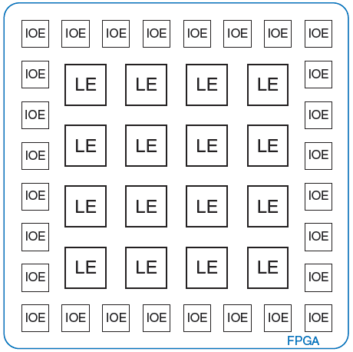
General FPGA Layout

Slide 137
LE: Logic Element
Composed of:
LUTs (lookup tables): perform combinational logic
Flip-flops: perform sequential logic
Multiplexers: connect LUTs and flip-flops

Slide 138
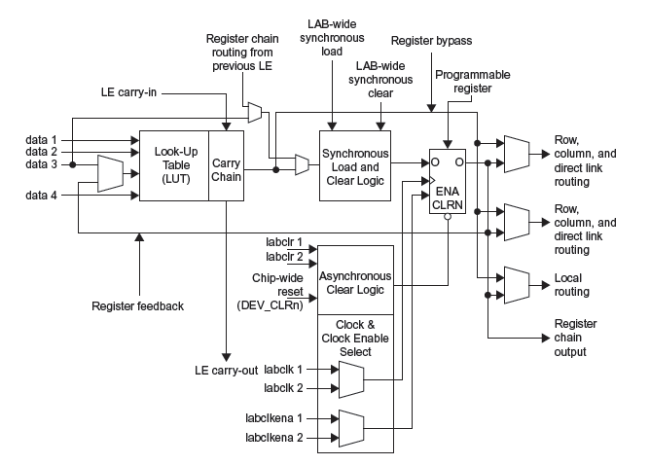
Altera Cyclone IV LE
From Cyclone IV datasheet

Slide 139
Altera Cyclone IV LE
The Altera Cyclone IV LE has:
1 four-input LUT
1 registered output
1 combinational output

Slide 140
LE Configuration Example
Show how to configure a Cyclone IV LE to perform the following functions:
X = ABC + ABC
Y = AB

Slide 141
Logic Elements Example 1
How many Cyclone IV LEs are required to build
Y = A1 ⊕ A2 ⊕ A3 ⊕ A4 ⊕ A5 ⊕ A6
Solution:
2 LEs
First computes Y1 = A1 ⊕ A2 ⊕ A3 ⊕ A4 (function of 4 variables)
Second computes Y = Y1 ⊕ A5 ⊕ A6 (function of 3 variables)

Slide 142
Logic Elements Example 2
How many Cyclone IV LEs are required to build
32-bit 2:1 multiplexer
Solution:
32 LEs
A 1-bit mux is a function of 3 variables and fits in one LE
A 32-bit mux requires 32 copies

Slide 143
Logic Elements Example 3
How many Cyclone IV LEs are required to build
Arbitrary FSM with 2 bits of state, 2 inputs, 3 outputs
Solution:
5 LEs
One LE can hold a bit of state and the next state logic, which is a
function of 4 variables (2 inputs, 2 bits of state)
One LE can compute a bit of output, which is a function of
2 variables (2 bits of state)
Thus 2 LEs are needed for state and 3 LEs for outputs

Slide 144
FPGA Design Flow
Using a CAD tool (such as Altera’s Quartus II)
Enter the design using schematic entry or an HDL
Simulate the design
Synthesize design and map it onto FPGA
Download the configuration onto the FPGA
Test the design

Slide 145
About these Notes
Digital Design and Computer Architecture Lecture Notes
© 2021 Sarah Harris and David Harris
These notes may be used and modified for educational and/or non-commercial purposes so long as the source is attributed.

